Slide 1
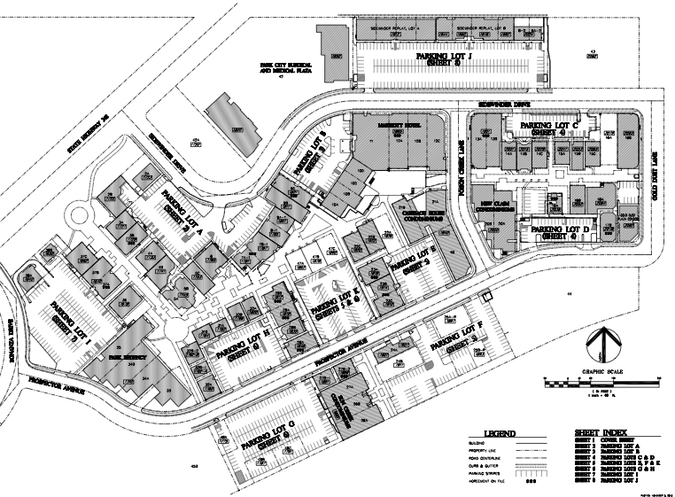
Property Owners Association

Slide 2
BOARD MEETING AGENDA June 26, 2024 | 4:00-5:30 pm | Park City Lodging, Second Floor Open Meeting, Dean Berrett, Board President Board Attendance Recorded – Guests - Agenda Overview Approval of prior meeting minutes May 15, 2024 City Council Report, Bill Ciraco Financial Report, Craig May 31 Report AR Update
Property Owners Association

Slide 3
Master Plan Phase 3 Update, Dean Berrett & Craig Dennis Parking Enforcement, Craig Dennis Budget Presentation Executive Director Report, Craig Dennis Board Nominations Annual Meeting
Property Owners Association

Slide 4
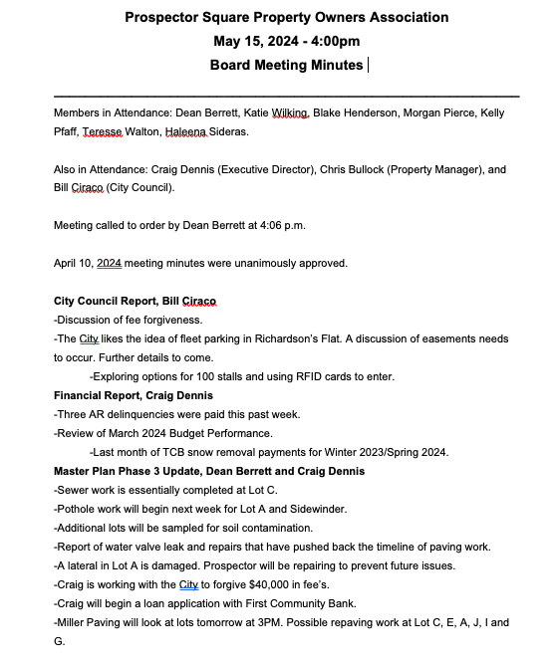
Property Owners Association
Approval of
Minutes

Slide 5
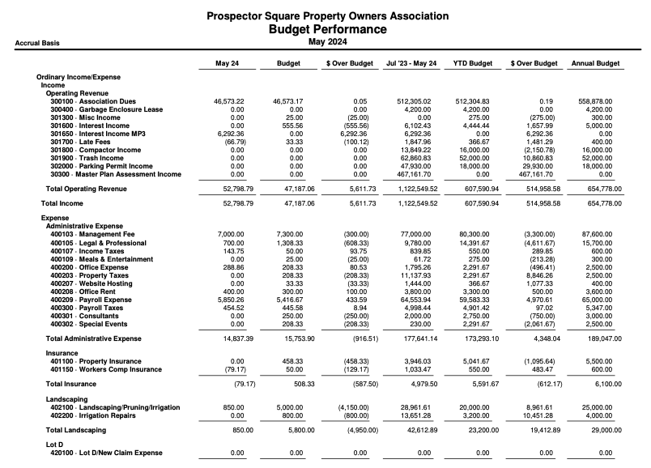
Property Owners Association

Slide 6
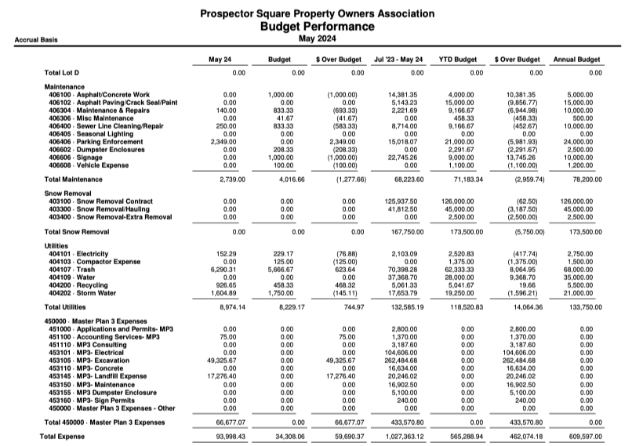
Property Owners Association

Slide 7
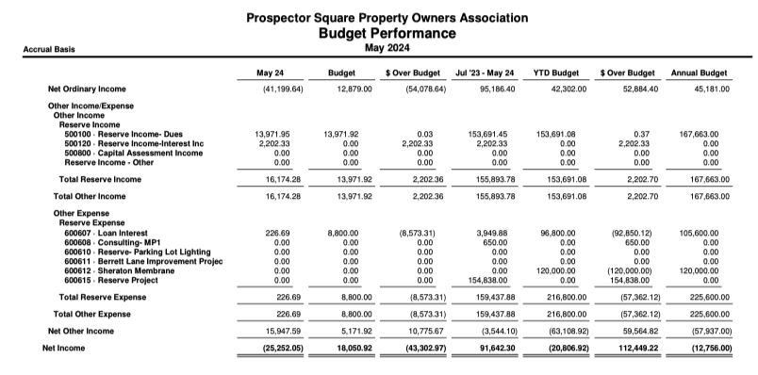
Property Owners Association

Slide 8
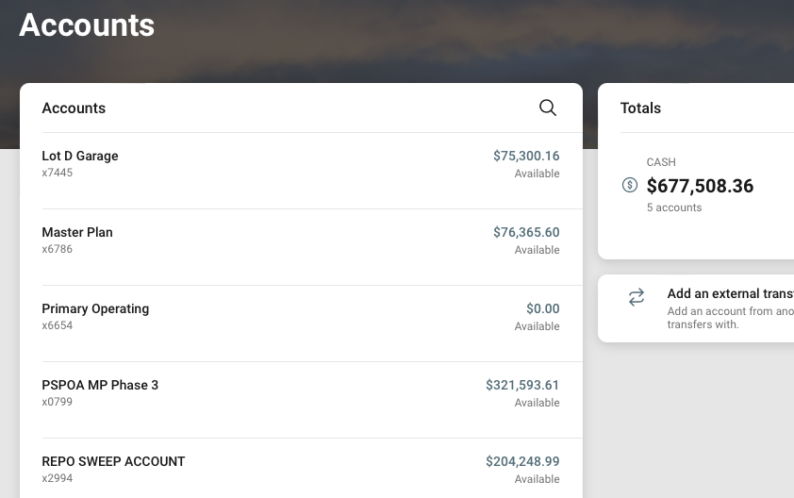
Property Owners Association

Slide 9
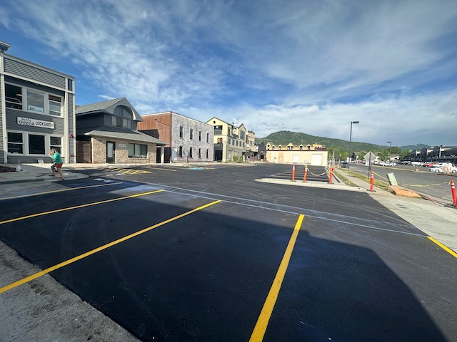
Property Owners Association
Master Plan Phase 3 Update
Lots C & E
DONE
Fuegos Lot

Slide 10
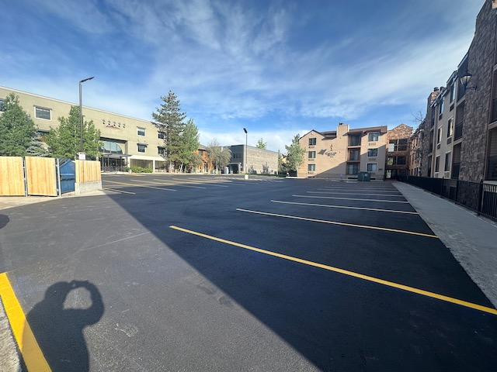
Property Owners Association
Master Plan Phase 3 Update
Lots C & E
DONE
Carriage House Lot

Slide 11
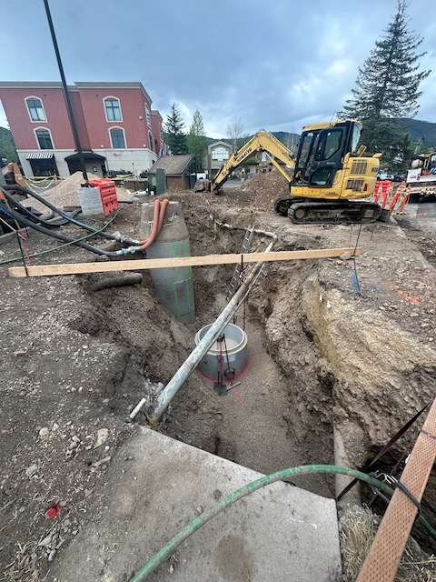
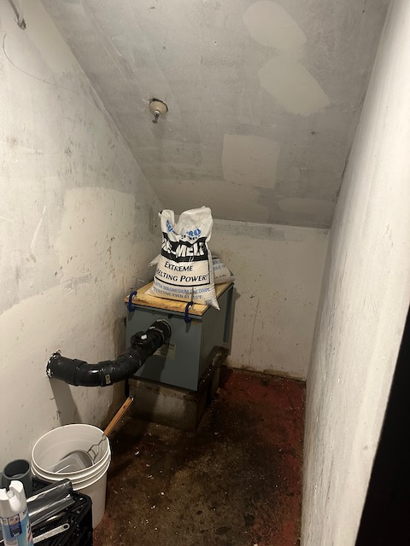
Property Owners Association
Master Plan Phase 3 Update Now in Lot A
Fee Forgiveness
Loan Application Started, First Community Bank
1.25% origination fee, prime plus one % Meadow Bank
Grease Trap at Albertos

Slide 12
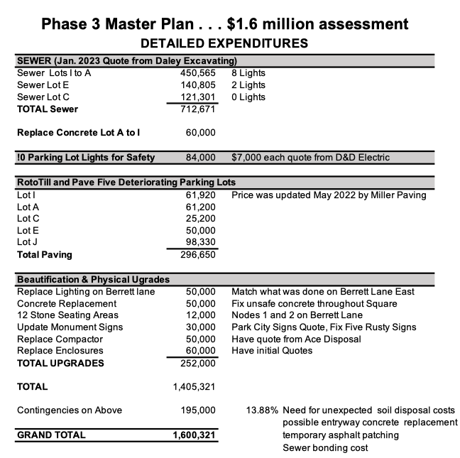
Property Owners Association

Slide 13
Property Owners Association
Parking Enforcement Update Online Registration
Please see hand-out
Feedback

Slide 14
Property Owners Association
2024/25 Budget Presentation
Adopt at Today’s meeting
Asphalt Preservation Bids, $42,000
Increased Garbage $6,000
Increased Signage, $2500
Operating Income Now $32,000
NOTE: No Interest Costs Budgeted

Slide 15
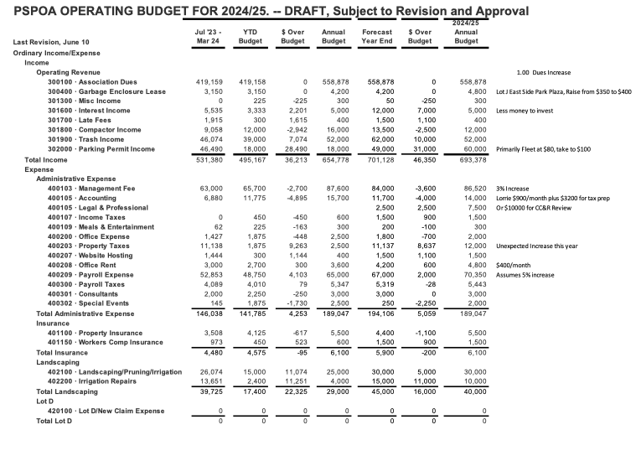

Slide 16
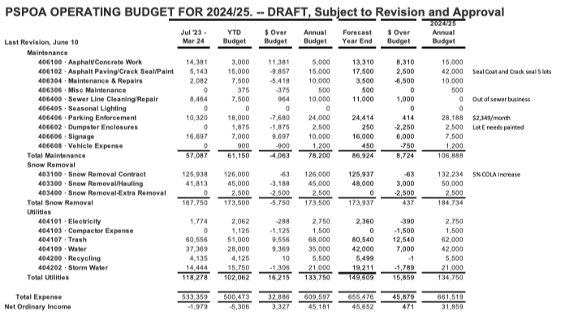
Property Owners Association

Slide 17
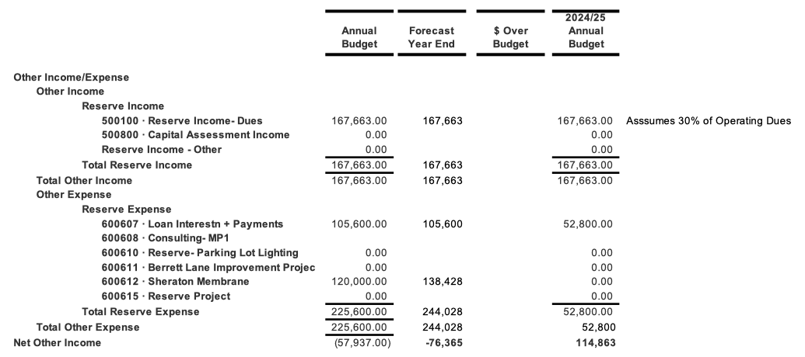
Property Owners Association
Capital Reserve Collection

Slide 18
Property Owners Association
Executive Director’s Report
Joe Cronley Resignation from Board
Summer Projects
Lot D Garage Inspection, Report
Regus Building Opening
1800 Prospector
Bonanza Park Small Area Plan
City Council Tomorrow
Executive Committee Policy Discussion
Fee simple vs common . . . who pays
Sidewinder Paving July 16/17
Annual meeting, Wednesday, July 17
Notices Going Out By Monday

Slide 19
Property Owners Association
PSPOA can have up to 15 board members
Terms are up for:
Dean Berrett, board president
Katie Wilking, commercial broker
Jake Hardy, Ski Butlers -- Retiring
Heleena Sideris, Park City Lodging
John Logan, retired CPA, Suncreek
ONE YEAR REMAINING:
Alex Brown, Carriage House Joe Cronley, Edward Jones (resigned) Jay Niederhauser, CPA Terese Walton, Gaddis Investments
Patrick Van Horn, Owner, 2064 Prospector
Morgan Pierce, Park City Museum Kelly Pfaff, Prospect Executive Offices Blake Henderson, Regus/Wrona building
Board Member Nominations

Slide 20
Property Owners Association
Board Member Nominations
PSPOA can have up to 15 board members
With Joe and Jake moving on,
Now at 11
POTENTIAL NOMINEES DISCUSSION
Sam Shepherd, KIC is a go
Tim Ryan/Park Regency
New Sheraton GM
Corey Francis
Kelly Strankiewicz, Dermatology House

Slide 21
Property Owners Association
Feedback &
Discussion

